Slide 1

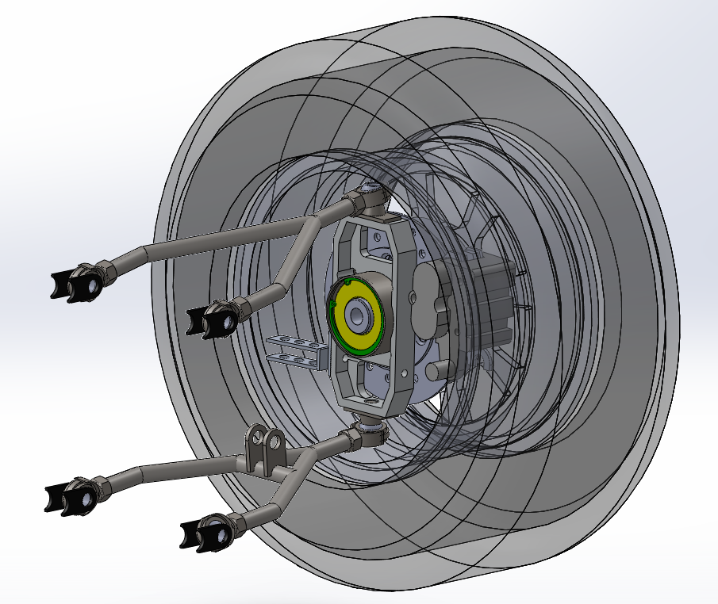
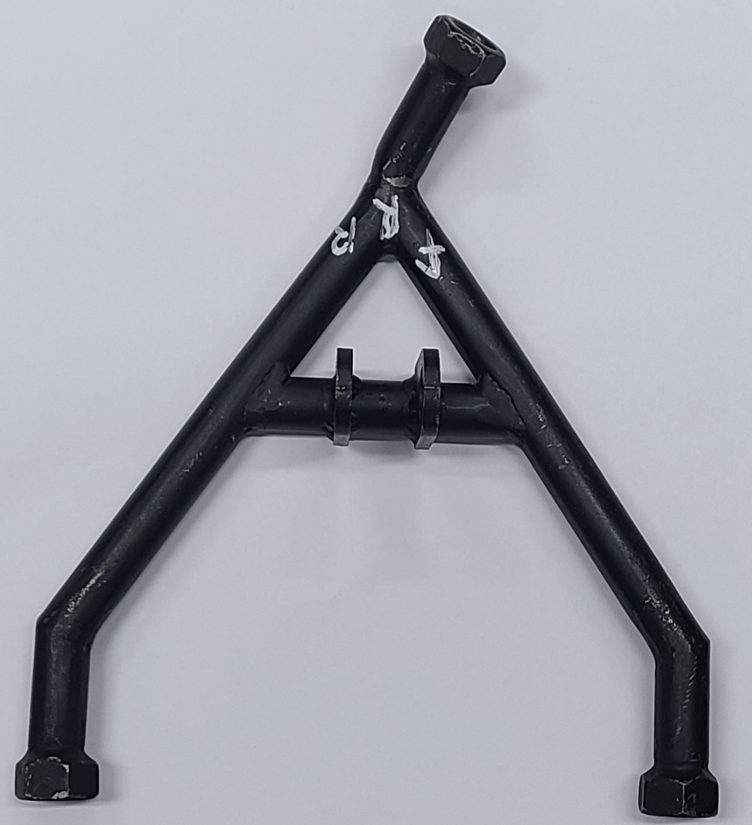
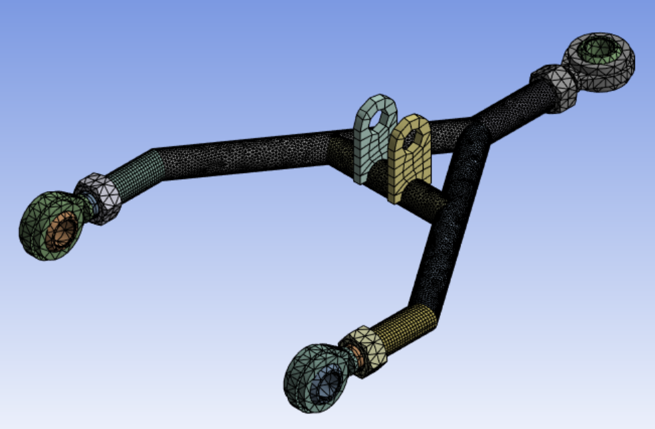
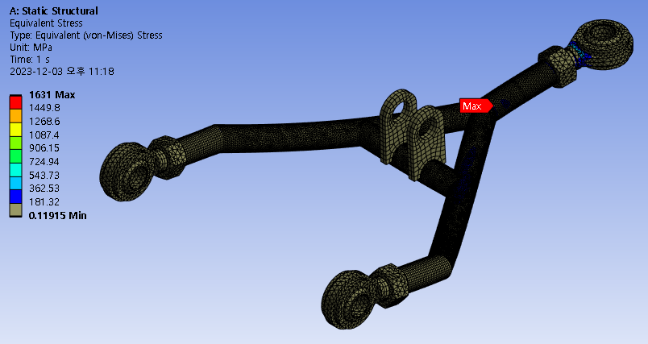
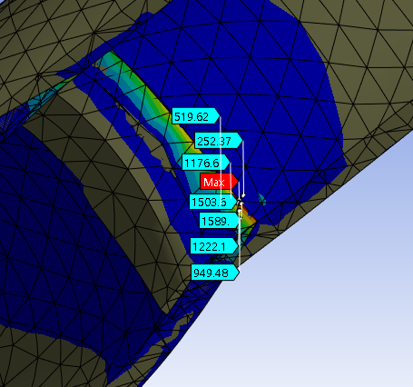
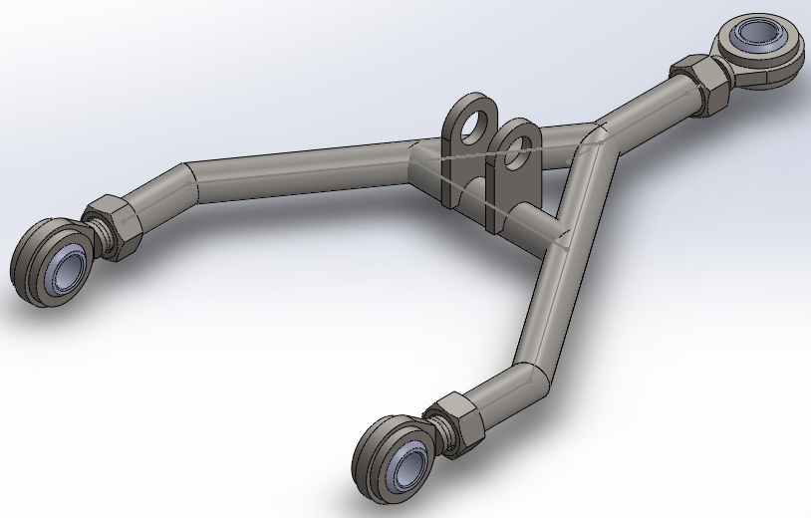
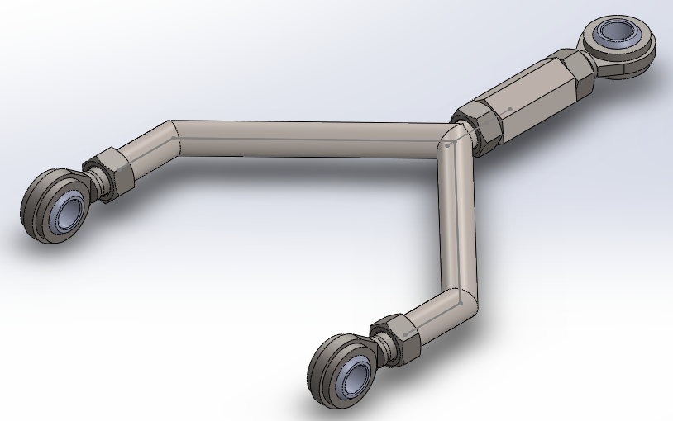
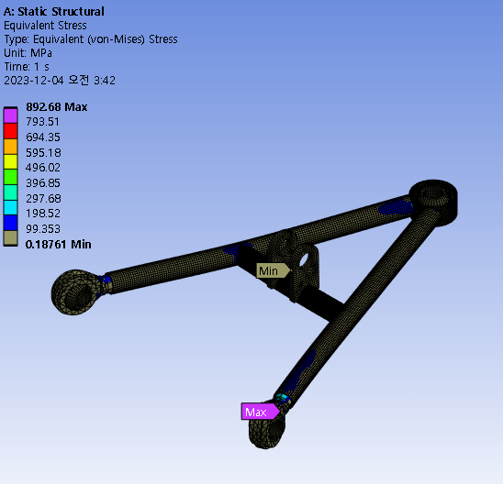
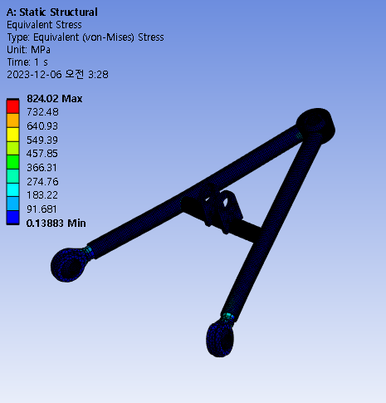
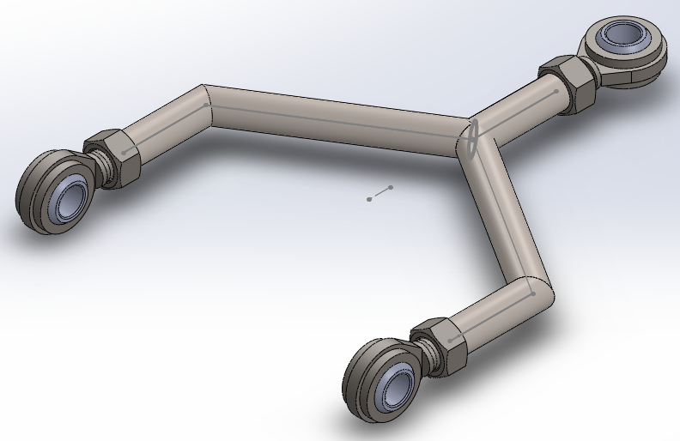
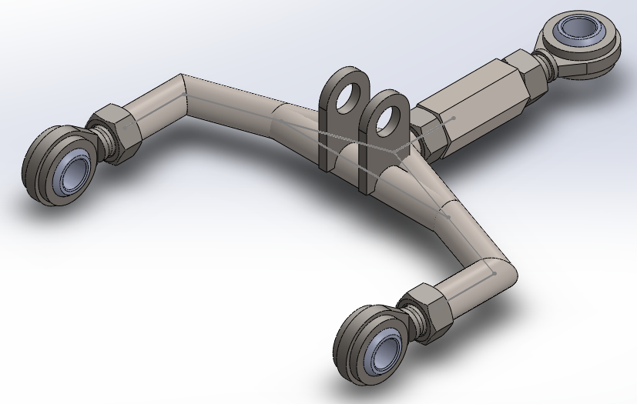
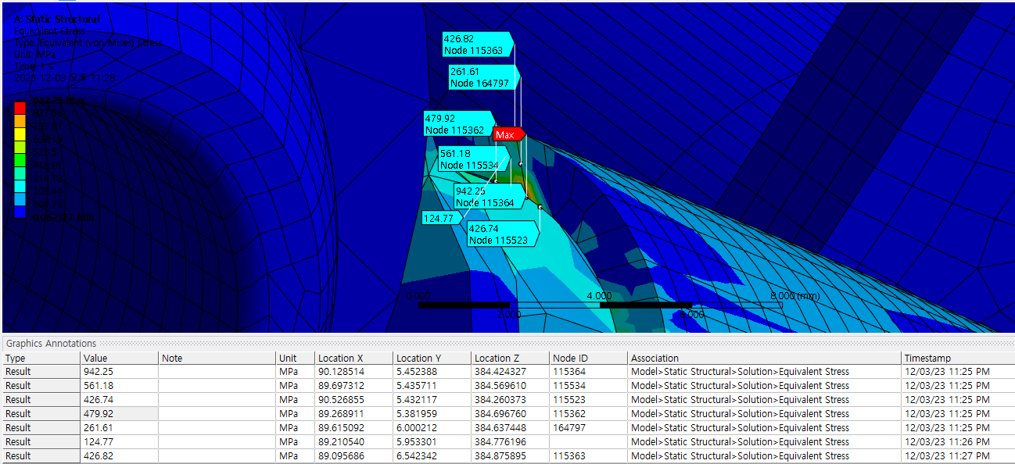
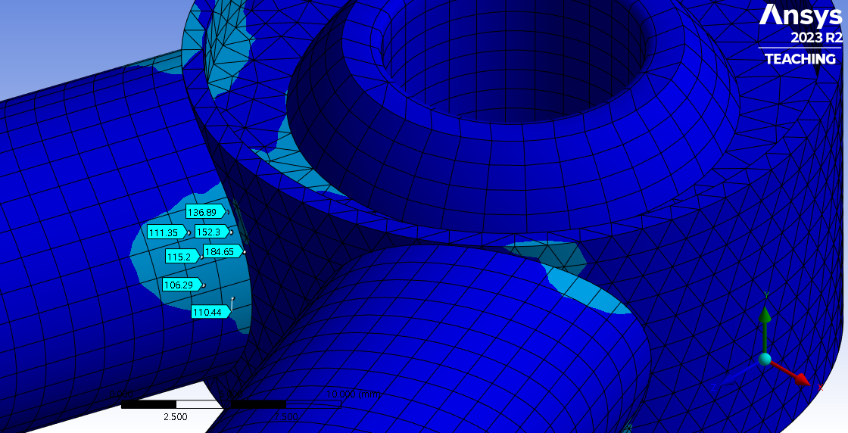
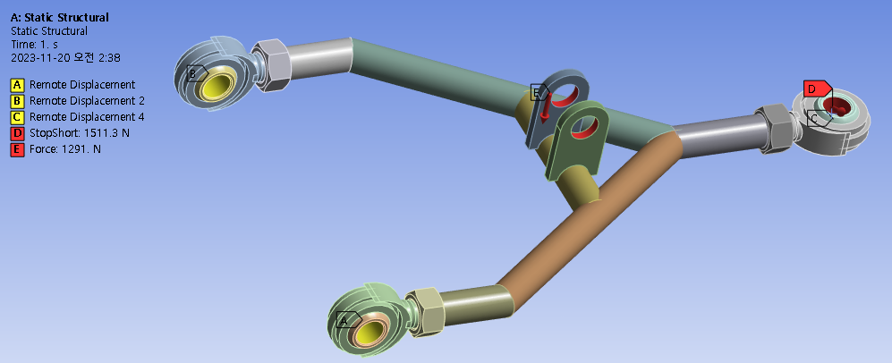
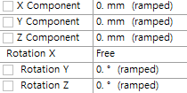
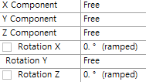
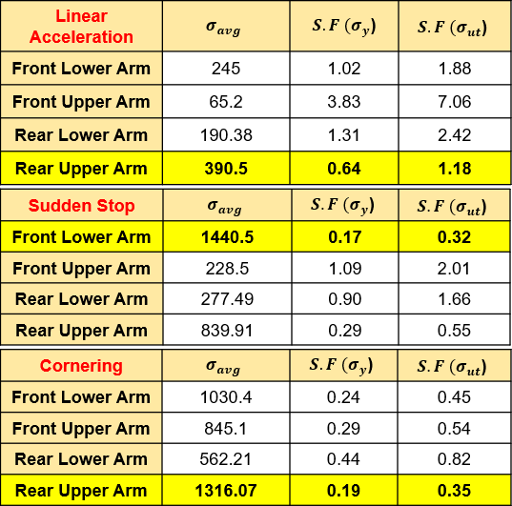
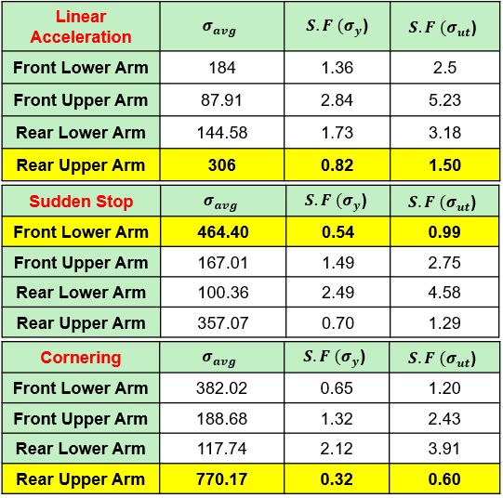
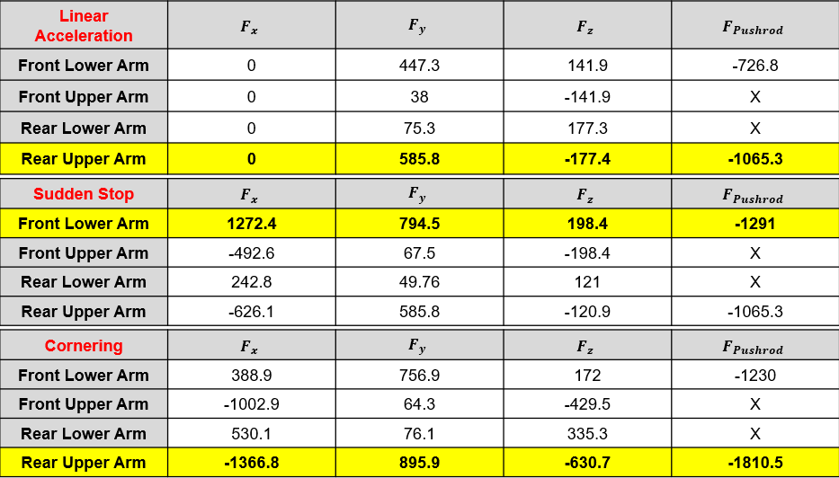
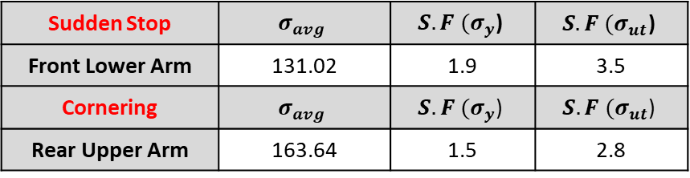
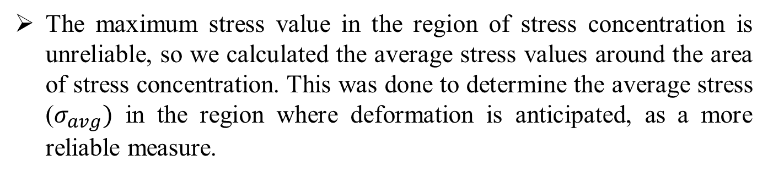


Armsys
21800330 Hyuni Park
21900416 Gyeonheal An
21900793 Taegeon Han
Improvement of the arm in the suspension system of an electric vehicle.
Advisor Professor : Chong-Sun LEE
Introduction
Mesh
Method
Automatic: Rod end bearing, Nut, Bracket
Body Sizing 2.75 (mm) : Bearing, Nut, Bracket
Body Sizing 2.5 (mm) : Rod end body
Body Sizing 1 (mm) : pipe
Simulation
Software: Ansys(Workbench R2023)
During the participation in a DIY car competition, an issue arose with the deformation of the suspension arm due to sudden braking during the driving test. Using 3D design and ANSYS analysis, a new suspension arm was designed to enhance the stability and performance of the vehicle during driving.
Problem Models
(a) Previous Model
(a) Front Lower
(b) Front Upper
(c) Rear Lower
(d) Rear Upper
Software: SOLIDWORKS 2012
Boundary, Contact, Load Condition
Boundary Condition
(b) Developed Shape Model (1T)
(c) Developed Model (1.5T)
The maximum stress value in the region of stress concentration is unreliable, so we calculated the average stress values around the area of stress concentration. This was done to determine the average stress ($σ_{avg})$ in the region where deformation is anticipated, as a more reliable measure.
Conclusion
Load Condition: Linear Acceleration & Sudden Stop & Cornering
(a) Old Version
(b) Developed Shape Model (1T)
Sudden Stop | $$σ_{avg}$$ | $$S.F (σ_{y}\text{)}$$ | $$S.F (σ_{ut}\text{)}$$
Front Lower Arm | 131.02 | 1.9 | 3.5
Cornering | $$σ_{avg}$$ | $$S.F (σ_{y}\text{)}$$ | $$S.F (σ_{ut}\text{)}$$
Rear Upper Arm | 163.64 | 1.5 | 2.8
Safety Factor for Yielding
$$S.F(σ_{y})=\frac{σ_{y}}{σ_{avg}}$$
Safety Factor for Tensile
(c) Developed Model (1.5T)
$$S.F(σ_{ut})=\frac{σ_{ut}}{σ_{avg}}$$
Contact Condition: All Bonded
In a sudden braking scenario, the load is concentrated forward due to inertia, with the Front Lower Arm bearing the most significant load. In a cornering situation, the Rear Upper Arm experiences the highest load due to the outward inertia of the vehicle.
Upon improving the shape of the Arm to prevent stress concentration, it was observed that the average stress decreased by more than five times. Furthermore, increasing the thickness of the pipe in the improved design by 0.5mm resulted in an average stress reduction of more than ten times compared to the original Arm.
We set the boundary condition to allow rotation at the bearing contact in the bearing. For the load condition, we divided it into three scenarios (Linear acceleration, Sudden stop, Cornering) and analyzed them through Free Body Diagrams (FBD).
The forces acting on the parts connected to the wheels were determined in the X, Y, and Z directions, while the force entering through the pushrod was assumed to be applied in the direction perpendicular to the lever

